Slide 1

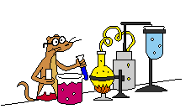
DRIVER DROWSINESS DETECTION
DRIVER ALERT- 3D
Capstone Project
The Machine Learning and Deep Learning Show 2021

Slide 2
Acknowledgements
We have taken a lot of effort into this project. However, completing this project would not have been possible without the support and guidance of a lot of individuals. We would like to extend our sincere thanks to all of them.
We are highly indebted to our mentors, Vedant, Rucha, and Harsh for their guidance and supervision. We would like to thank them for providing necessary information and resources for this project.

Slide 3

Thank you to all those who supported us!

Slide 4
TABLE OF CONTENTS
01
02
03
INTRODUCTION AND OVERVIEW
MAJOR REQUIREMENTS
PROJECT GOALS
Main objective was to build a Deep Learning model which could detect driver’s drowsiness.
Implementing the image classification model into an Android app with real time image capturing.
Datasets, TensorflowLite, Android sdk studio, Google colab, OpenCV library etc.

Slide 5
TABLE OF CONTENTS
04
05
06
PROJECT STAGES
SNEAK PEEK
FUTURE SCOPE
Various stages of the project in Android platform are discussed in this section.
A glimpse into the outcome of the Capstone Project - Driver Alert- 3D Suite
The importance of this project, future scope of R&D and improvements are listed here.

Slide 6
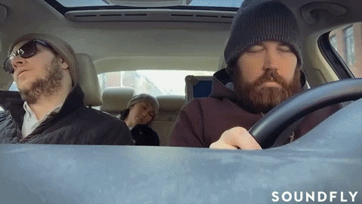
INTRODUCTION
Drowsiness is one of the major cause for accidents. Every year 10-15% of the accidents are due to driver drowsiness.
Drowsiness can be defined as an transition from awake state to sleep state.

Slide 7
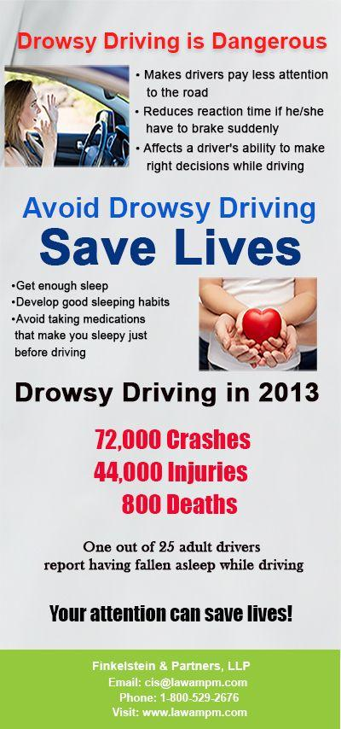
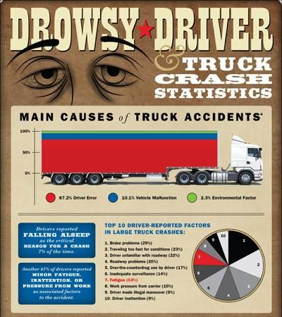

Slide 8

Please click on the video to play
Module 1:- Drowsiness Detection and Recognition (with text-speech recognition)

Slide 9
—Betty williams
“There's no use talking about the problem unless you talk about the solution.”

Slide 10
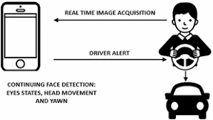
OVERVIEW OF THE SOLUTION
The aim of this project is to develop a Drowsiness Detection System. Main focus was placed on designing a system that would monitor the open or closed state of the eyes, yawn or no yawn face, in real time.
By monitoring the eyes and face, it is believed that symptoms of fatigue can be detected early enough to avoid an accident.

Slide 11
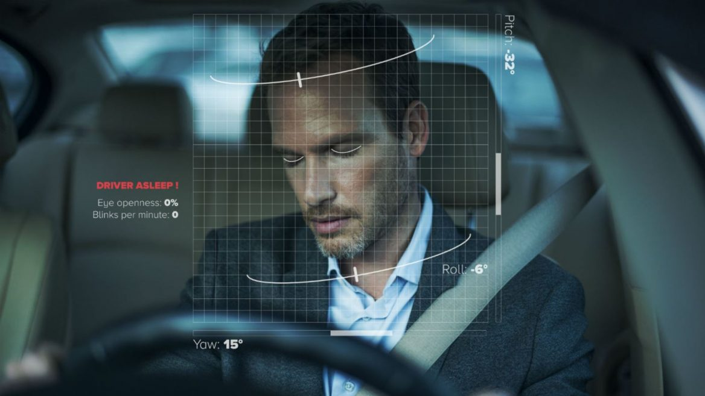
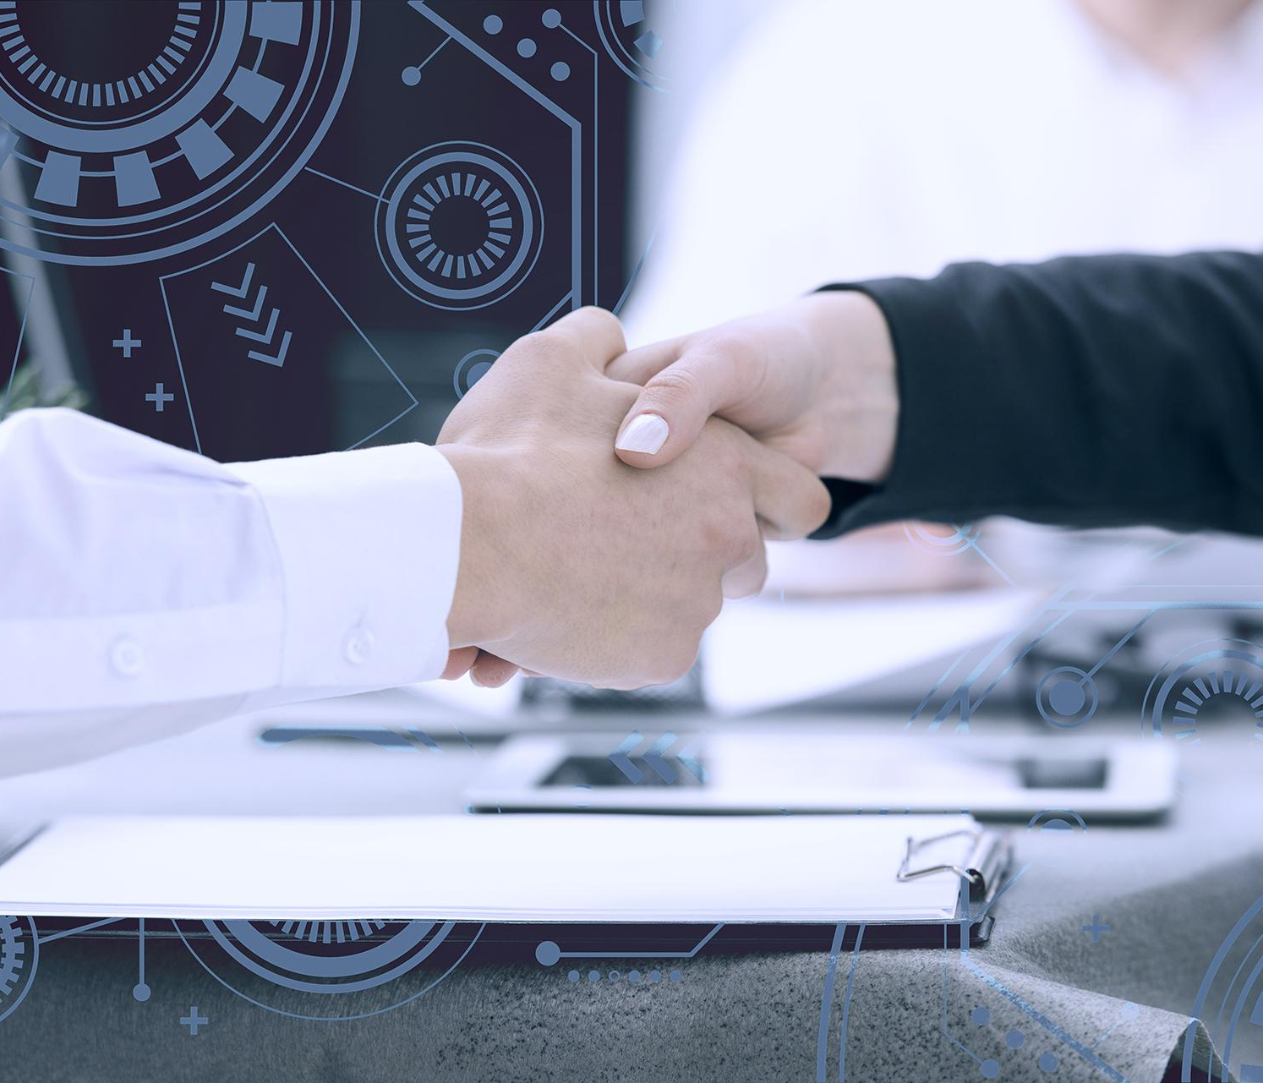
ABOUT THE PROJECT
The proposed work is to alert the driver when he is drowsy by the means of speech mechanism. In this project real time data is collected by video camera. This data gives information about driving condition of the driver which acts as input to the controller. The output is then converted into speech and is heard by the driver.

Slide 12


MAJOR REQUIREMENTS
DATASETS
TENSORFLOW LITE
OPENCV LIBRARY
ANDROID SDK STUDIO
Darkness Detector
HAAR CASCADE CLASSIFIER
Datasets for Open & Closed eye, Yawn & Not yawn, all for light and dark
Mostly used in python to perform neural network algorithm and plot graphs for testing
Models namely facenet.tflite, flowermodel.tflite were generated and used as assets
Generated and combined a rarely available apk consisting of four to five sub modules
Luminance scale 0-255 used and generated self trained python models mainly based on environment luminosity
Used in server and client side app making, which after due authorization, drivers can access

Slide 13

sOFTWARES AND FILES USED
OpenCV library
Haar Cascade Classifier
Tensorflow Lite
Python Shell
Android sdk
facenet_model.tflite
Python Library pkgs
Keras
CameraX API
Dlib Android

Slide 14
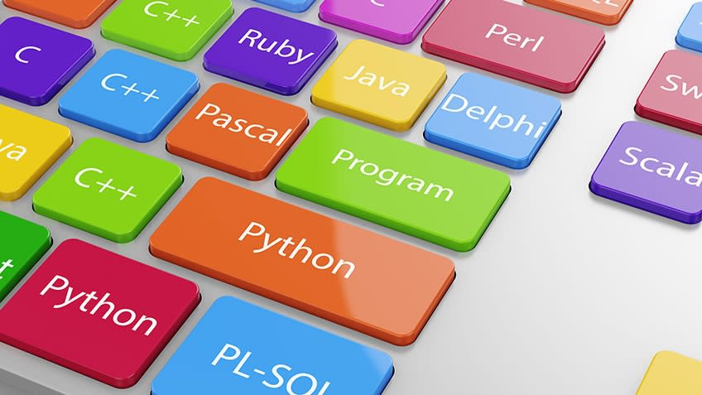
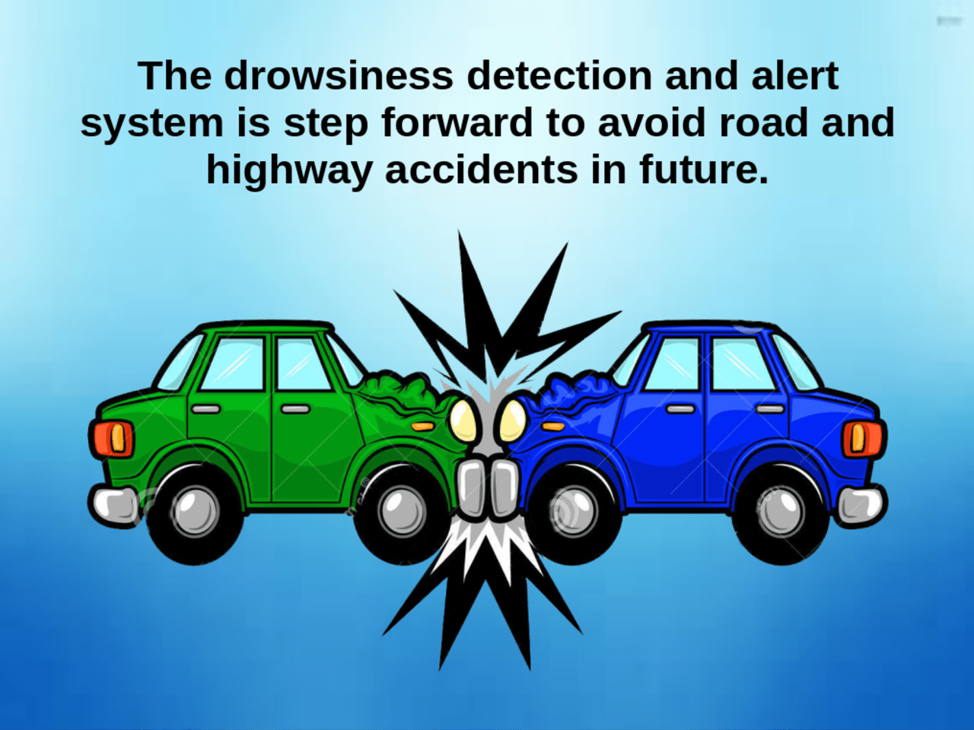
Programming languages used
Python
Kotlin
Java
Xml
Tensorflow
Android

Slide 15
Opencv library
What is OpenCV? | Why OpenCV?
OpenCV is an open source computer vision library, designed for computational efficiency and has a high focus on real time image processing. It provides simple to use computer vision platform, which allows us to build the sophisticated vision application quickly. Used by most of the companies such as Sony, Intel, Microsoft and Google. | Execution speed is fast than Matlab. Costumes less memory which is important for the embedded platform. Interpretation time is less, as OpenCV is programmed using optimised C language. Cross platform support for different operating systems.

Slide 16
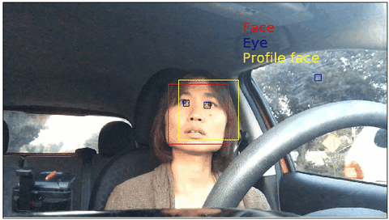
Haar cascade classifier
A Haar Classifier is a machine learning approach for visual object detection originally developed by Viola and Jones. It was originally intended for facial recognition but can be used for any object.
Haar Cascade classifier has two stages- training and detection of the object.
The haar classifiers quickly reject regions that are highly unlikely to contain the object and the object detection can move on to further region. It does this by making use of the cascade of classifiers.
The necessary applications for implementing a Haar classifier are included in OpenCV and they can be used to train a classifier for detecting objects in an image.

Slide 17
Please click on the video to play
Module 2: Real-Time Face Drowsy condition Detection

Slide 18
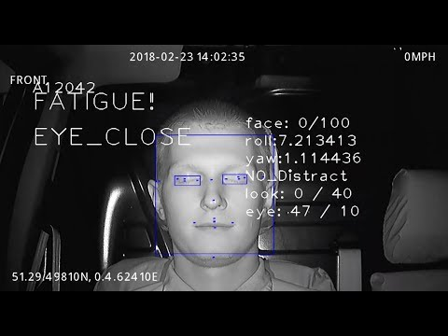
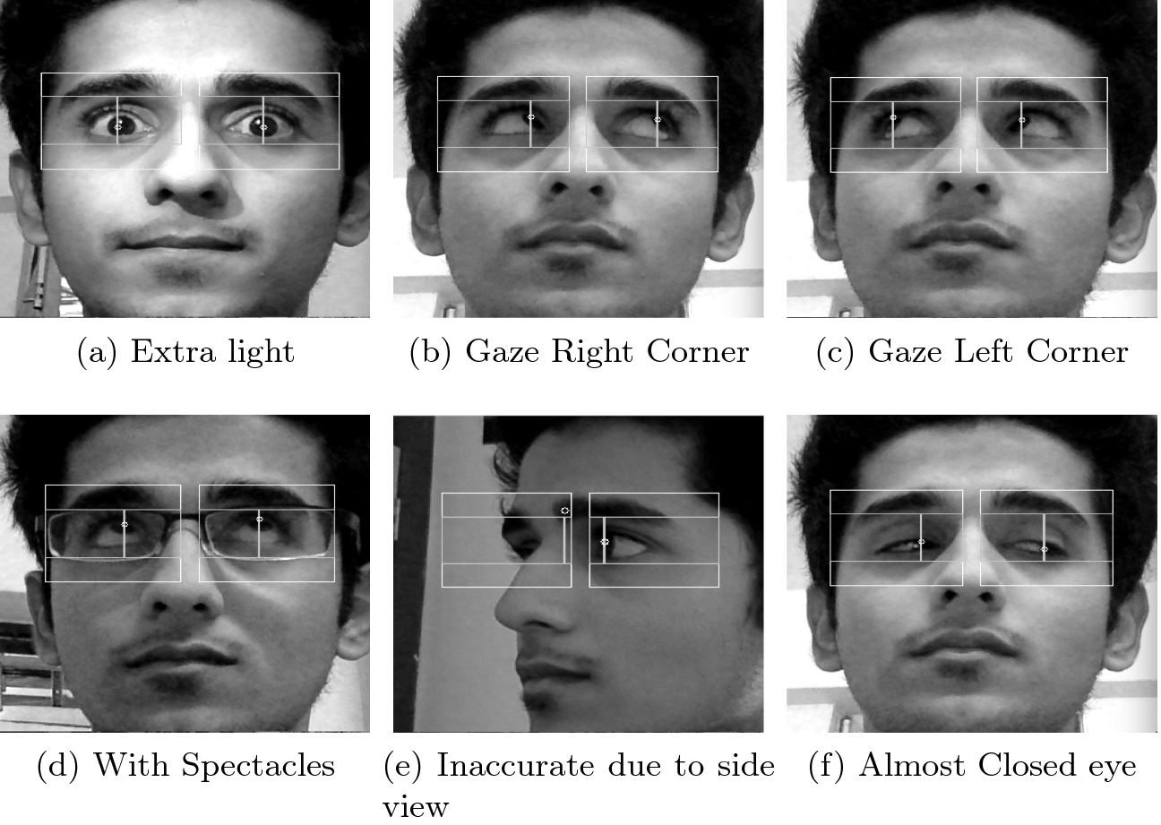
Darkness detection and recognition
Algorithms used: Architectures of ML and Deep Learning: EAR and EYE Aspect ratios were calculated, Transrect functions were used, mapping from Bitmap to YUV coherence and finally bounding box were calculated. Alarm detection was enabled. Subparts of each app consists of both recognition as well as detection, thus making the apk coherent (16% luminance achieved).

Slide 19

ANDROID SDK STUDIO
Android supports a wide variety of machine learning tools and methods: The ML design guides, Google's turnkey machine learning SDK ML Kit, TF Hub for finding pre-built cutting edge models, TF Lite Model Maker to train an existing model with your own data, and ML Kit custom models and Android Studio for integrating these models into an app.

Slide 20
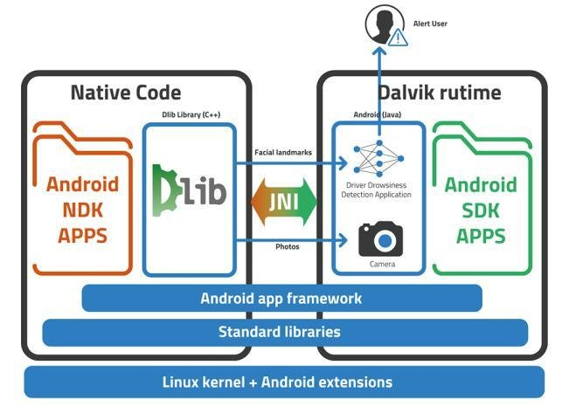
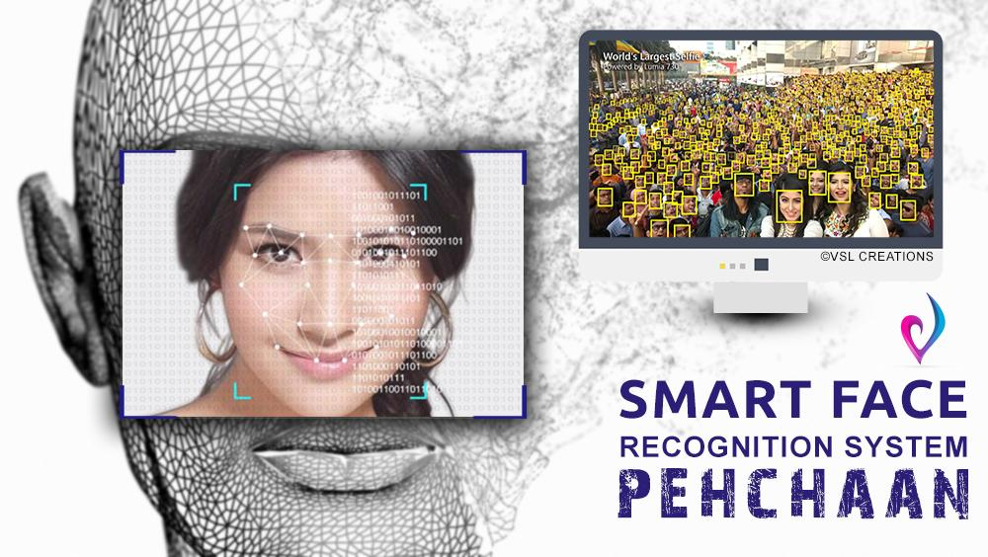

Android deep Learning framework
Libraries Used: dlib, library, opencv, ML kIt, Firebase, Lazy library module
Multiple Manifests merged into one to produce the resulting apk.

Slide 21
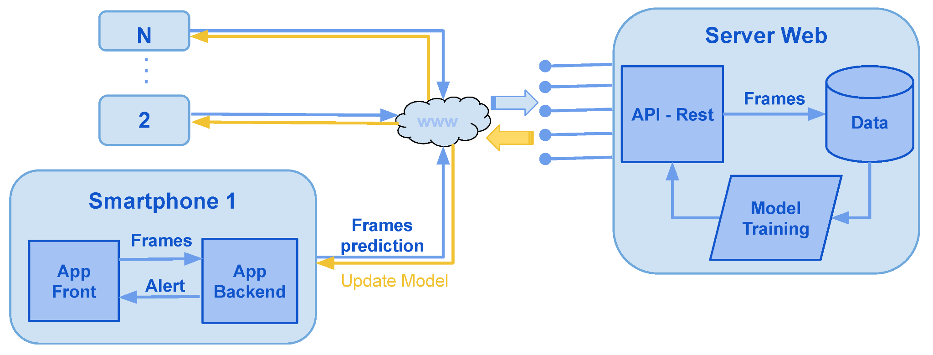
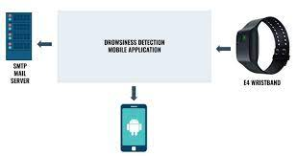
Server-client relationship app
Native server interface: Records driver drowsiness in dark and light.
Client side app: Face recorded, face identified and captured.
Smaller module for generalization of any IoT system or normal transmitter-receiver app easily mainframes with car trackers.

Slide 22
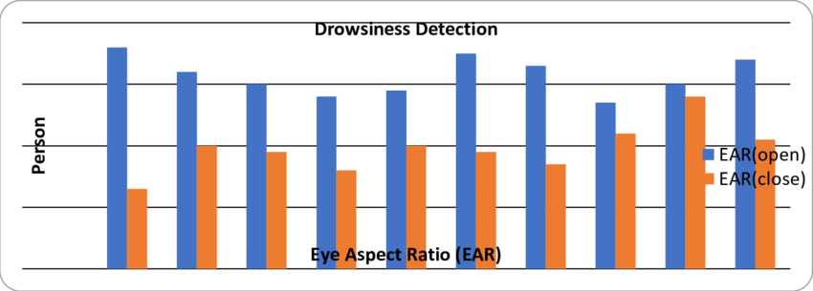
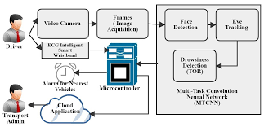
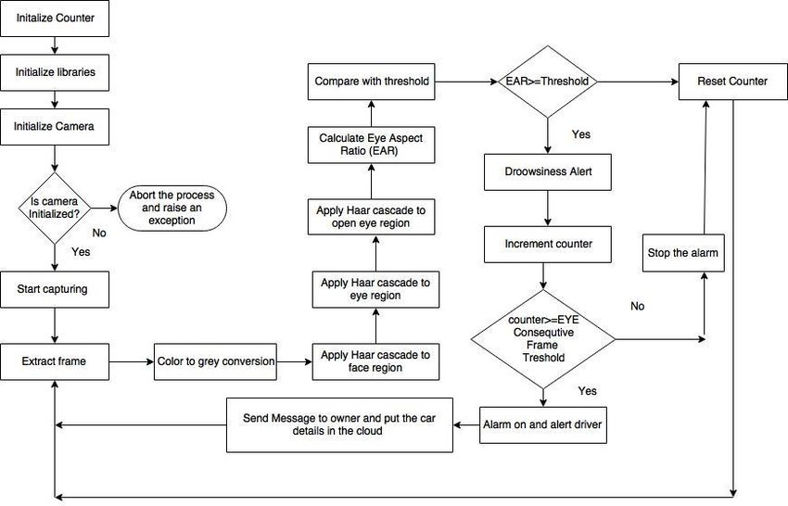
Opencv vs Server-Client App
Server side and Client side app were finally formulated using python, Amazon EWS, localhost and android interface. The basic difference between opencv and server real time applications are depicted here:

Slide 23
01
PREPARING THE IMAGE CLASSIFICATION MODEL
Using various Deep Learning and Machine Learning algorithms, we designed our image classification model and then trained and tested it on the collected datasets.

Slide 24
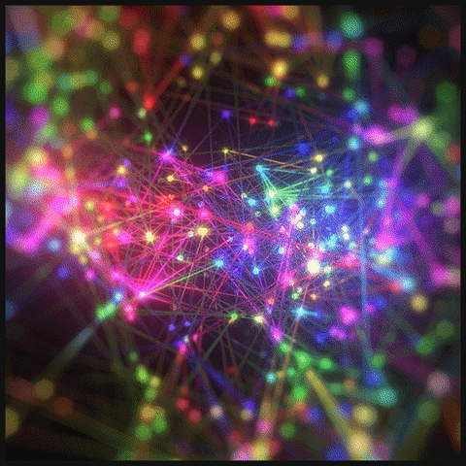
LET’S TALK NUMBERS!
Training Accuracy achieved:- 85-88%
Testing Accuracy:- 79%
Number of datasets:- 2000-2500

Slide 25
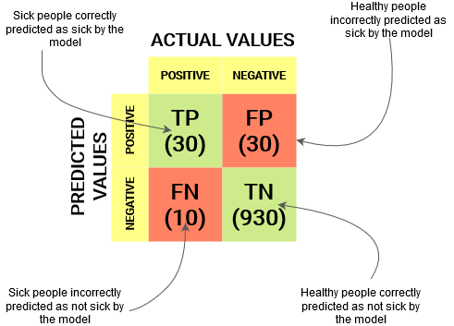

Deep learning TABLE
 | OPEN | CLOSED | YAWN | NO_YAWN
Accuracy | 0.87 | 0.86 | 0.89 | 0.86
PRECISION | 0.81 | 0.798 | 0.76 | 0.88
RECALL | 0.75 | 0.79 | 0.87 | 0.76
F1- score | 0.76 | 0.87 | 0.78 | 0.86
Support | TENSORFLOW, KERAS, OPENCV, SCIKIT-LEARN

Slide 26

STEPS IN BUILDING THE DEEP LEARNING MODEL
COLLECTING THE IMAGE DATASETS FOR VARIOUS CLASSES
implementing THE CLASSIFICATION ALGORITHM
Training and testing THE MODEL
CONVERTING THE MODEL INTO A .TFLITE MODEL TO BE USED IN TENSORFLOW LITE

Slide 27
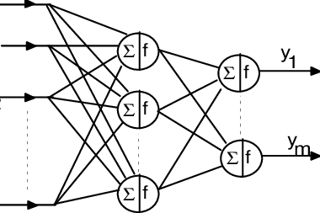
PREDICTED RESULTS
Requirement of alert based system in cars for preventing accidents due to driver fatigue and carelessness will result into more precaution.

Slide 28
02
RECOGNISING IMAGES WITH TENSORFLOW LITE ON ANDROID
Module 1 -- Recognition and detection
Module 2 -- Driver Drowsiness Login and authentication

Slide 29

INTRODUCTION
TensorFlow is a multipurpose machine learning framework. TensorFlow can be used anywhere from training huge models across clusters in the cloud, to running models locally on an embedded system like your phone.
Using TensorFlow Lite Model Maker, we trained our own custom image classifier.

Slide 30
Analysis and programming
Training the image recogniser using Google Colab. Download the trained model (model.tflite), and rename the file, for example as FlowerModel.tflite.
Setting up the working directory.
Setting up the Android skeleton app.
Add TensorFlow Lite to the Android app.Select the model location where you have downloaded the custom trained facenet.tflite earlier.
On clicking Finish, you will see the following at the end. The FlowerModel.tflite and facenet.tflite models are successfully imported and it shows the high level information regarding the model including the input / output as well as some sample code to get you started.
Run the custom model with TensorFlow Lite. Accelerate the inference with GPU Delegate. Integrate the app with login authentication to test server side for drowsy driver.

Slide 31
PROJECT GOALS
BUILDING THE DEEP LEARNING MODEL
IMPLEMENTING THE MODEL INTO AN ANDROID APP
After training and testing of the model, use of image enhancers for dark/dim images, obtaining the accuracy, the model was ready to be implemented.
The model, for both light and dark images, was implemented into an android app with additional text-to-speech converting features.

Slide 32
Please click on video to play
Module 3:- Server-Server Drowsiness Detection – Part 1
Logging in the database to access server-to-server communication

Slide 33
03
ANDROID APP DEVELOPMENT
Deep Learning in android to recognize drowsy drivers in dark and bright light environments.

Slide 34


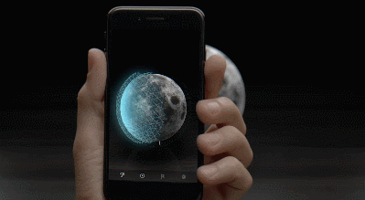
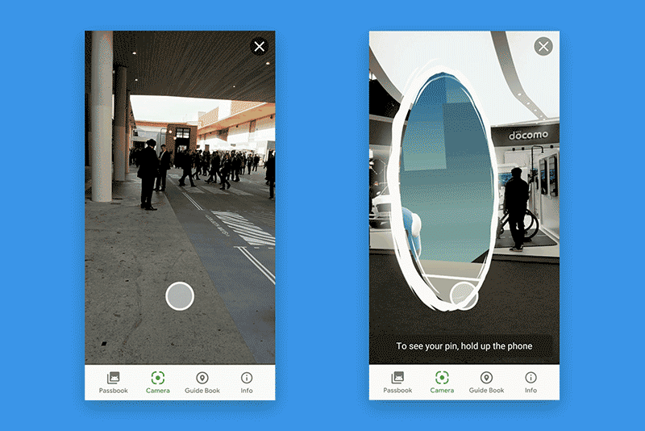
Firebase and google ml kit
ML-Kit Implementation:
FaceNet model using Google ML Kit dependency in android. Augmented reality of Snapchat’s database used for real time analysis also.
Firebase Implementation: Firebase database used to store user driver credentials. Dependency used for face recognition and detection.

Slide 35
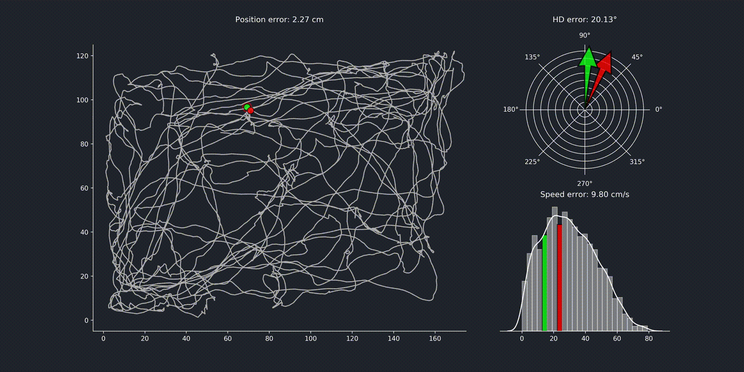


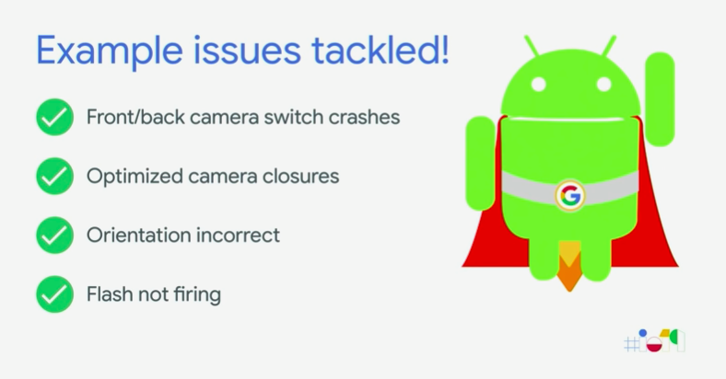
Deep learning convolution network and camerax api
Deep learning network automation and CameraX tracking have been compiled in the Face detect api model.

Slide 36
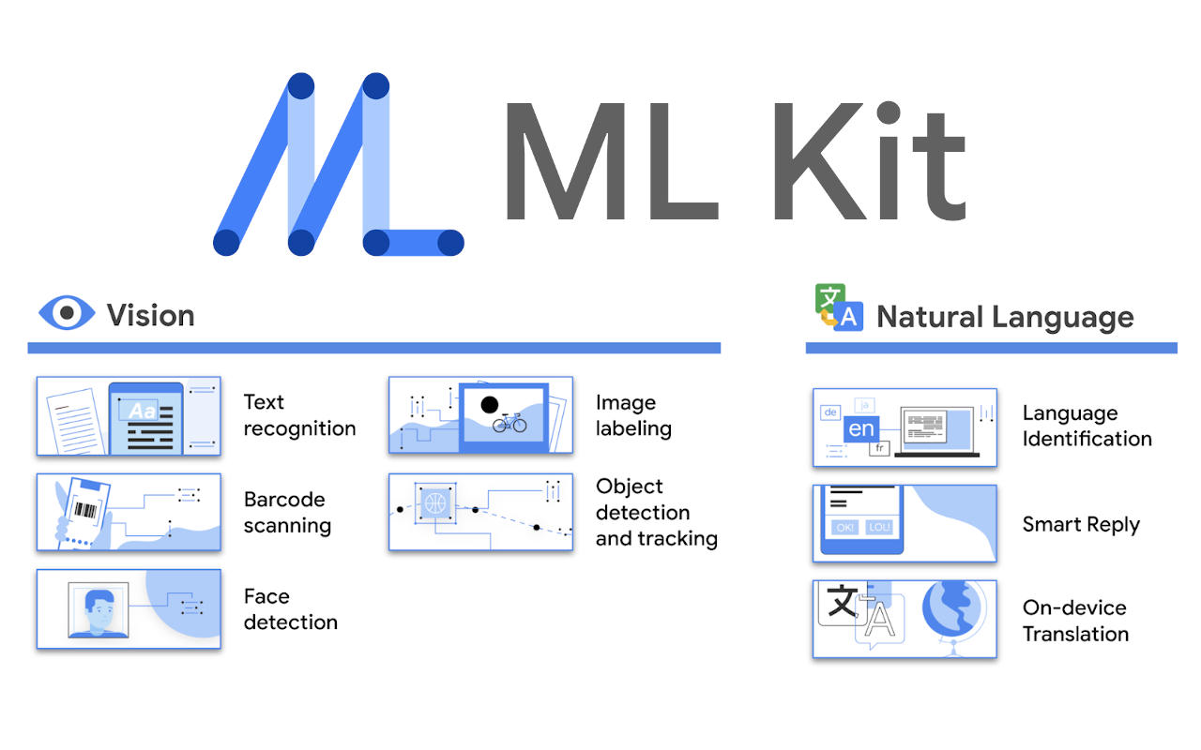
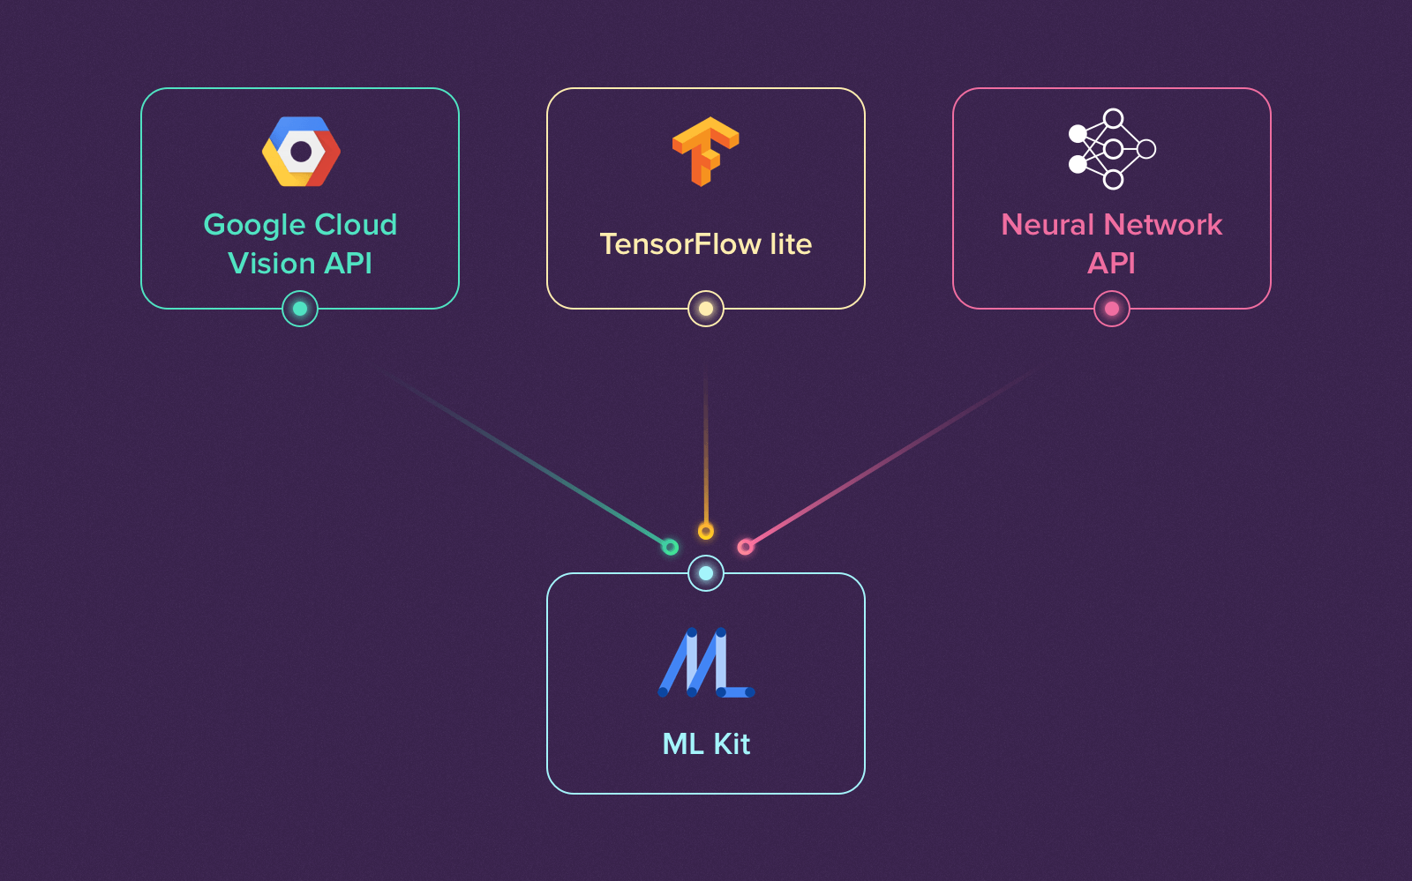
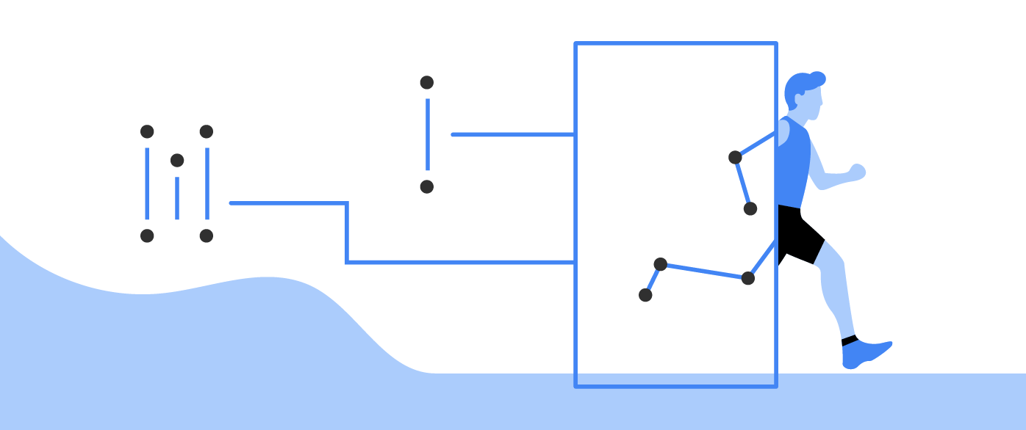
Bitmap and yuv to rgb conversion and vice versa
Essential step to convert all camera frames from RGB to Bitmap and YUV and again back to RGB. Other processes like translation, scaling, flipping, mapping, dimensioning, analyzing have been implemented only with the help of Firebase, Google Ml-Kit, Cloud-API and TFLite to make the CameraX API viable and usable on Android platforms.

Slide 37

Android allows you convert your
text into voice.Android provides TextToSpeech class for this purpose.
In order to use this class, you need to
instantiate an object of this class and
also specify the initListener.
Generated speech modulated for
Testing in dark and light
environments, Automatic speech
without large number of button
presses.
TEXT TO SPEECH
CONVERSION
Text to Speech App converts the text
written on the screen to speech like you
have written “Hello World” on the screen
and when you press the button it will speak
“Hello World”
Alert based intrusion system
developed with Voice and music
recognition to detect when people get drowsy in cars.

Slide 38
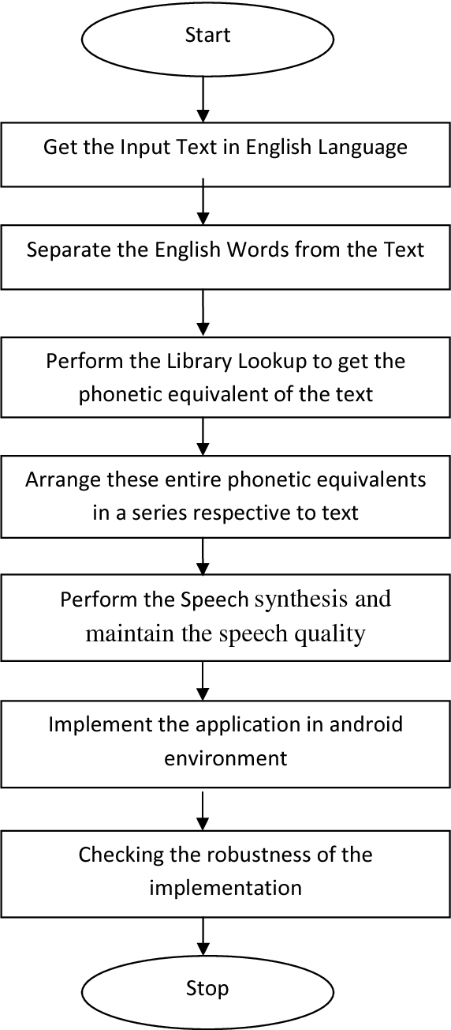
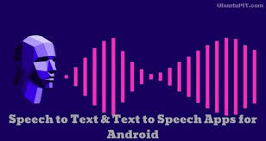
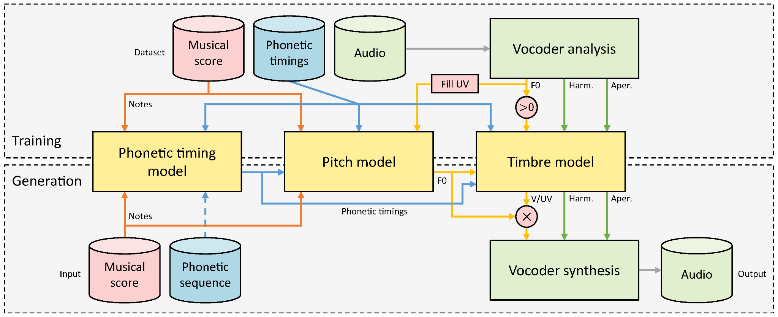
Text-to-speech

Slide 39
04
REAL-TIME FACE RECOGNITION
Four cruds supporting front and back cameras for detecting eyes and faces for liveliness detection.

Slide 40
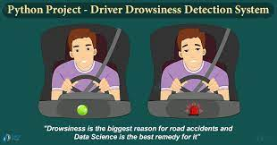
Face data gathering and plotting
Tensorflow and ML-KIT are designed for computational efficiency and with a strong focus on real-time applications. So, it’s perfect for real-time face recognition using a camera.
To create a complete project on Face Recognition, we must work on 3 very distinct phases:
Face Detection and Data Gathering
Train the Recognizer
Face Recognition

Slide 41
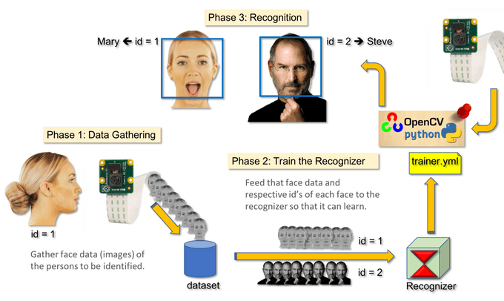
The below block diagram resumes face recognition phases:

Slide 42
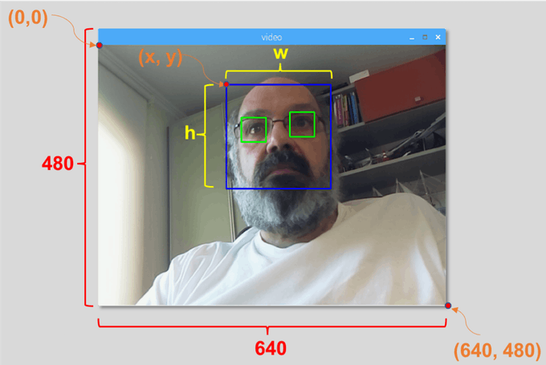
Face Detection
The most basic task on Face Recognition is “Face Detecting”. Before anything,we must “capture” a face (Phase 1) in order to recognize it, when compared with a new face captured in future (Phase 3).
The most common way to detect a face (or any objects), is using the “Haar Cascade classifier”. It is a machine learning based approach where a cascade function is trained from a lot of positive and negative images. It is then used to detect objects in other images.

Slide 43
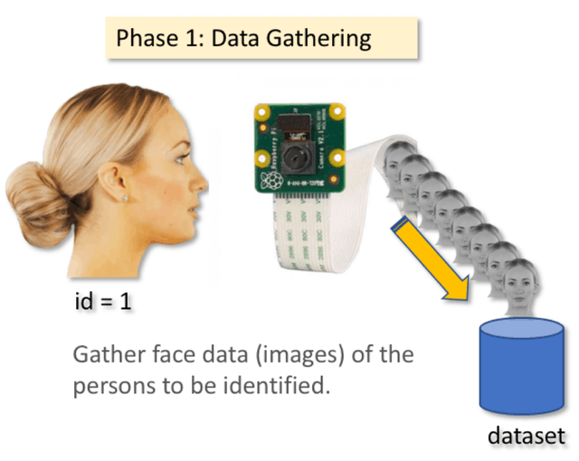
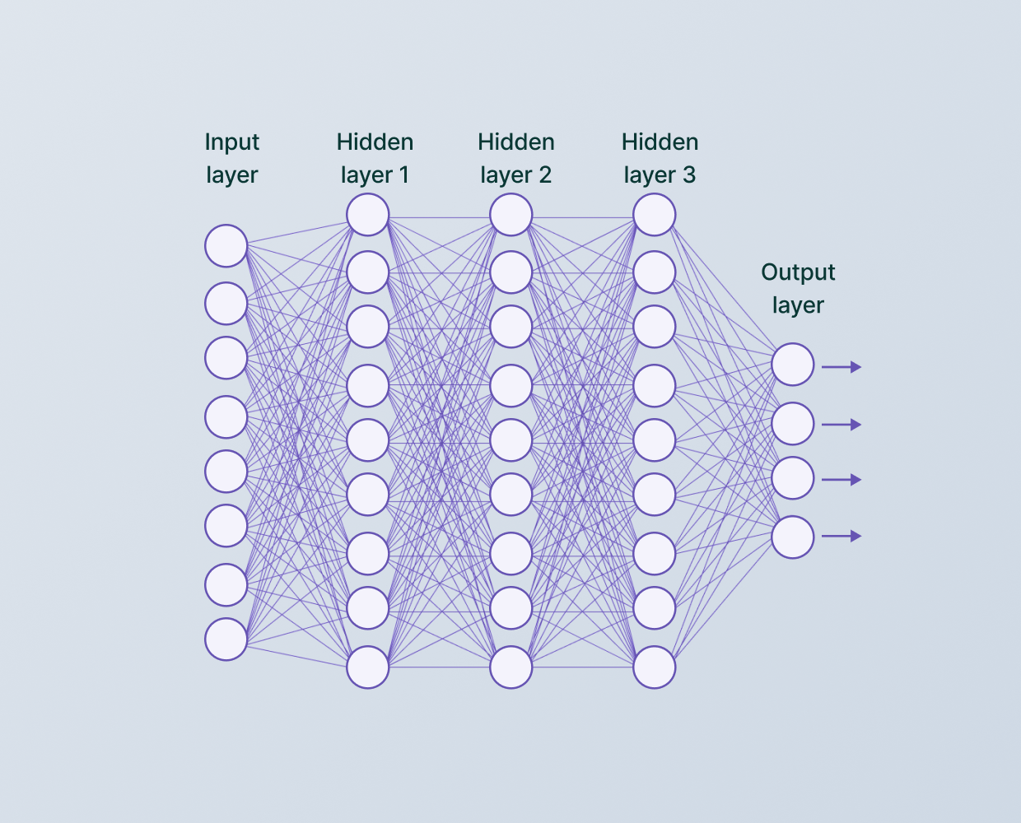
Data Gathering
In this phase, we simply created a dataset, where for each id, we stored a group of photos in gray with the portion that was used for face detecting.

Slide 44
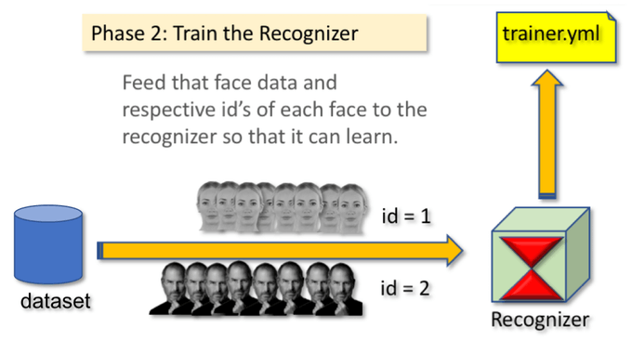
Trainer
On this second phase, we must take all user data from our dataset and “trainer” the OpenCV Recognizer. This is done directly by a specific OpenCV function. The result will be a .yml file that will be saved on a “trainer/” directory.

Slide 45
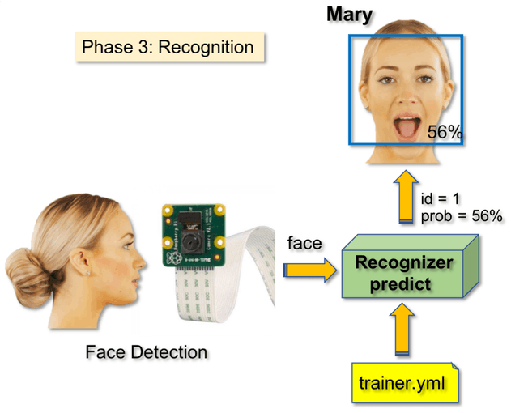
Recognizer
Now, we reached the final phase of our project. Here, we will capture a fresh face on our camera and if this person had his face captured and trained before, our recognizer will make a “prediction” returning its id and an index, shown how confident the recognizer is with this match.

Slide 46
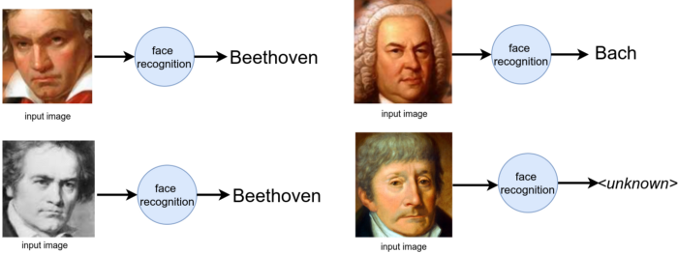
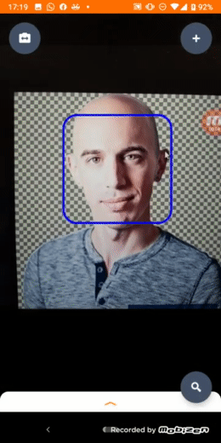
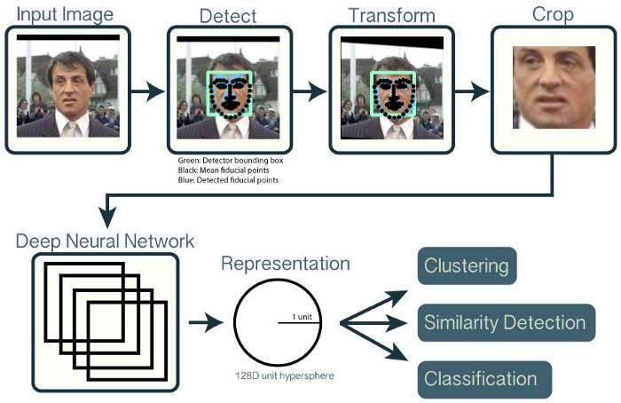
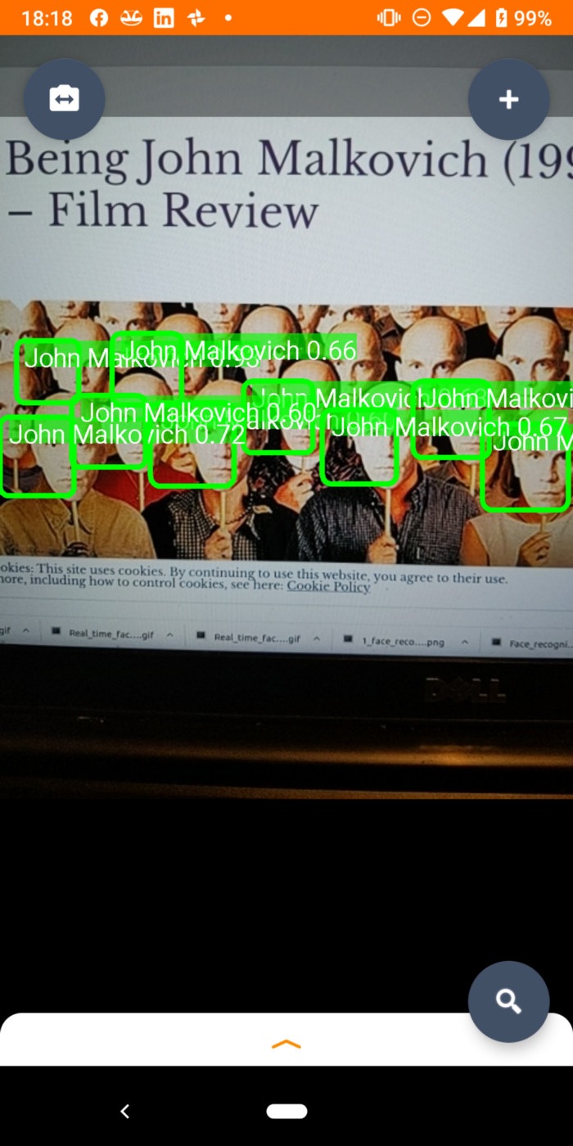
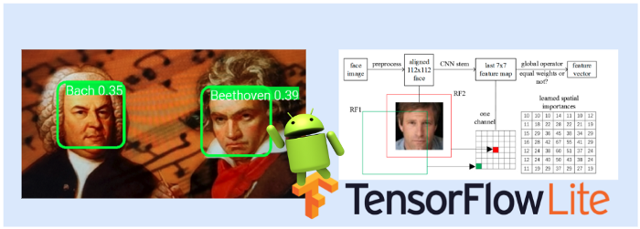
PROJECT STAGES
Training faces real-time and recognizing them
S
Samples of different faces collected
Tensorflow Lite models generated and sparse matrix calculated
More than one face recognized and labelled

Slide 47
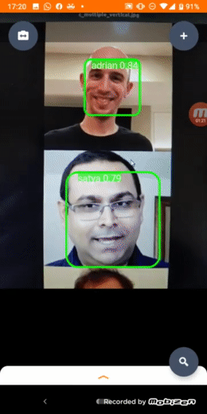
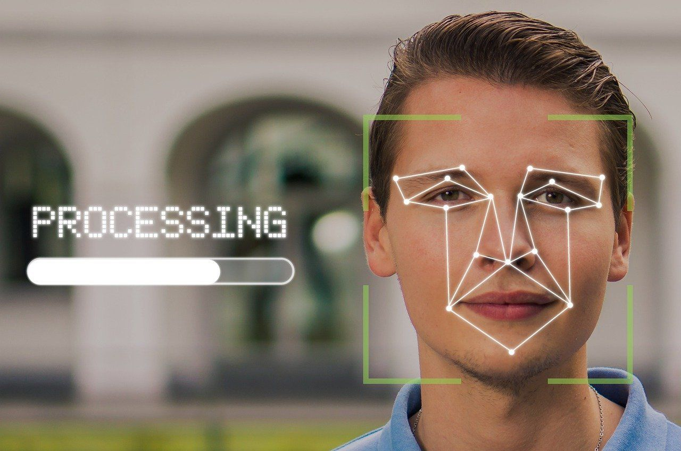
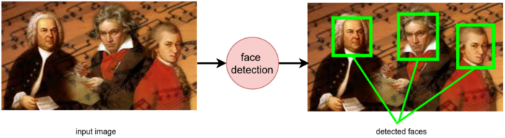
Real time face recognition
Faces are recognized through nearest distance algorithm and confidence interval locked in bounding box. An input image is fed to the detector and detected faces are received at the output.

Slide 48
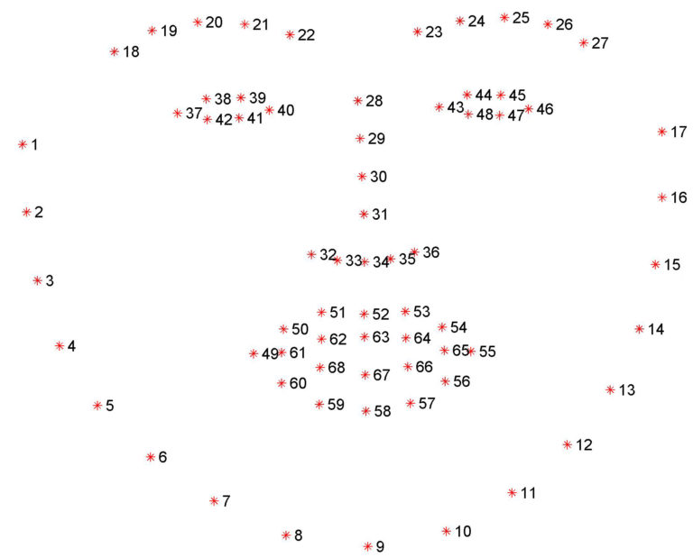
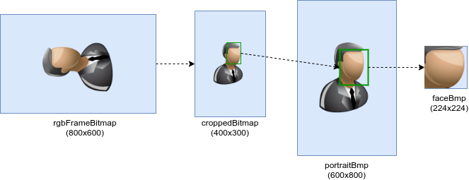
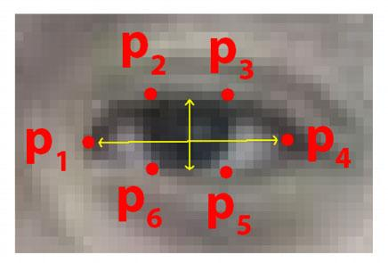
Plotting and detecting eyes and faces
Mapped face coordinates
Frame Bitmap conversion
Eye Detection
Each face is converted to bitmap images and are cropped for better resolution.
Eyes are detected through measurement of horizontal and vertical widths.
Faces are inverted and the coordinates of left and right axes are plotted

Slide 49
Module 3:
Server-Server Drowsiness Detection - Part 2
Face drowsy condition getting recorded on mobile at the driver end
All statistics of driver alert getting recorded at server side

Slide 50

SNEAK PEEK

Slide 51




OUR TEAM
Algorithm aces
AADIT PANt
Kamakshi verma
Soumya deep das
Worked alongside in development of android app, data gathering and training the model
Collected datasets required for training the classification model, worked in making the powerpoint presentation.
Coordinated the entire Capstone project. Successfully programmed the required apk.

Slide 52




THANKS!!
Do you have any questions?
#MLDLS 2021- CAPSTONE PROJECT

Slide 53

RESOURCES
VECTORS
Flat artificial intelligence background
Round about android deep learning environment and google ML Kit
Large database modules and dlib library packages for running real time applications on servers and mobile phones.
PHOTOS
Close-up of humans handshake with tech background
Futuristic technology screen interface and alarm as well as speech recognitions
Group of people in drowsy, semi-drowsy and awake conditions

Slide 54


The end….

